Slide 1


Slide 2

#LifeKoKaroLift
SGC Coaching Session 9:
STATISTICS RECALL
Session By: Mahendra

Slide 3
Agenda:
Recap of Inferential and Hypothesis Testing
Interpretation focused Understanding
Problem Solving in Hypothesis Testing
Examples
Personalized Feedback and Doubt Resolution

Slide 4
Quiz Time
When to use Permutation and when to use Combination?
Expected Answer: Check if the order matters or not. If it does, then use the permutations formula, and if does not, then use combinations!

Slide 5
Quiz Time
Formula for Permutation and Combination?
Expected Answer:
The formula for counting the number of ways to choose r objects out of a set of n objects is as follows: nCr=n!/r!(n−r)!
if there are n 'objects' that are to be arranged among r available 'spaces', then the number of ways in which this task can be completed is:
n!/(n-r)!

Slide 6
Quiz Time
What is Confidence Interval?
The correct interpretation of a 95% confidence interval is that "we are 95% confident that the population parameter is between LCV and UCV."
Example: Laptop Usage
A sample of 12th grade females was surveyed about their laptop usage. A 95% confidence interval for the proportion of all 12th grade females who use laptop between 3-5 hours a day was computed to be [0.612, 0.668].
The correct interpretation of this confidence interval is that we are 95% confident that the proportion of all 12th grade females who use laptop for 3-5 hours/day in the population is between 0.612 and 0.668.

Slide 7
Confidence Interval Examples and Interpretation
The confidence level refers to the long-term success rate of the method - how often this type of interval will capture the parameter of interest?
A specific confidence interval gives a range of possible values for the parameter of interest.
Example 1: Interpreting a confidence level
A media compony takes a random sample of 500 voters whether or not they support the incoming PM candidate. They are supposed to take the results of the sample and construct a 90% confidence interval for the true proportion of all voters who support the candidate.
What is the correct interpretation of the percent confidence level?
SAMPLE ANSWER 1: If the company repeats this process many times, then about 90% of the intervals produced will capture the true proportion of voters who support the candidate
Sample answer 2: If the agency repeats this process and constructs 20 intervals from separate independent samples, we can expect about 18 of those intervals to contain the true proportion of voters who support the candidate.
The stated confidence level means that we can expect 90 percent of these intervals to contain the parameter of interest, and 18 of 20 is 90%

Slide 8
Quiz Time
What is Probability and how do you calculate it?
Expected Answer: It means how likely is something to happen? It deals with calculating the likelihood of a given event’s occurrence.
Probability=No. of desired outcomes/ Total number of possible outcomes.

Slide 9
Quiz Time
Properties of Probability Values?
Probability values have the following two major properties:
Probability values always lie in the range of 0 to 1. The value is 0 in the case of an impossible event and 1 in the case of a sure event
The probabilities of all outcomes for an experiment always sum up to 1. For example, in a coin toss, there can be two outcomes, heads or tails. The probability of both of the outcomes is 0.5 each. Hence, the sum of the probabilities turns out to be 0.5 + 0.5 = 1

Slide 10
Quiz Time
What are P-values?
P values are the probability of observing a sample statistic that is at least as extreme as your sample statistic when you assume that the null hypothesis is true.

Slide 11
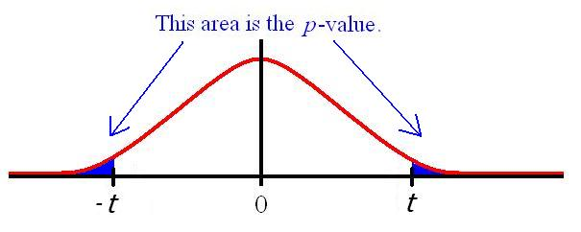
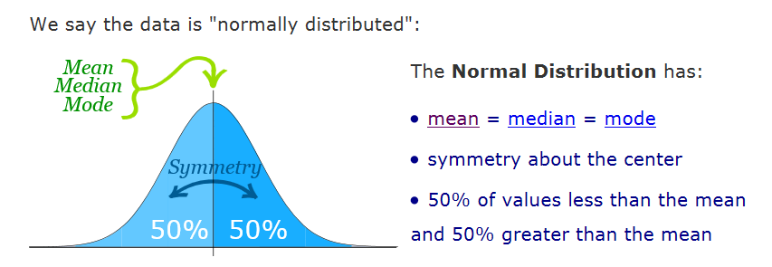
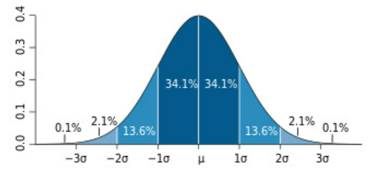
Recap and Summary : Hypothesis Testing
Data Understanding
Problem Diagnosis
Hypothesis Formulation
Evaluation
Prototype
Output
Hypothesis enables analysis of an assumption and root causes of investigation.
p- value: Level of Significance
Accept / reject null using critical regions
Image Source:https://dietassessmentprimer.cancer.gov/learn/distribution.html?hcb=1
Notes:
This is where tech background learners are most confused hence explanations need to be detailed.

Slide 12
Quiz Time
What is the critical value method and the p-value method?
Explain with sample numerical Examples

Slide 13


Recap – Critical Value Method
A manufacturer claims that the average life of his products is 36 months. An auditor selects a sample of 49 units of the product and after calculating finds the average life to be 34.5 months. Given the population Standard deviation is 4 months. Test the manufacturer’s claim at 3% significance level using the critical value method
SOLUTION:
STEP 1: Formulate the hypothesis. This is a two tailed test, hence Null and Alternate hypothesis are:
Ho : = 36 months, Ha : 36 months
STEP 2: Calculate the Z critical from the given value of alpha (significance level)
We have critical regions on both sides with total area of 0.03, hence area of the critical region on the right side is 0.015 i.e. area till UCV (the cumulative probability of that point) is 1-0.015 = 0.985.
The z score for 0.985 in the table is 2.17
Hence, The Z critical for two tailed test at 3% significance level is 2.17
STEP 3: Calculate the UCV and LCV from the value of Z critical.
Critical values can be calculated using the formula: μ ± Zc x (σ/√N) as 36 ± 2.17(4/√49) = 36 ± 1.24
Hence, UCV = 37.24 and LCV = 34.76
STEP 4: Make the decision:
Sample mean 34.5 is less than LCV, i.e. it lies in the rejection region(critical region), Hence you can reject the null hypothesis

Slide 14
Recap – p value Method
A manufacturer claims that the average life of his products is 36 months. An auditor selects a sample of 49 units of the product and after calculating finds the average life to be 34.5 months. Given the population Standard deviation is 4 months. Test the manufacturer’s claim at 3% significance level using the critical value method
SOLUTION:
STEP 1: Formulate the hypothesis. This is a two tailed test, hence Null and Alternate hypothesis are:
Ho : = 36 months, Ha : 36 months
STEP 2: Calculate the Z score of the sample mean point , calculate the z-score for the sample mean of 34.5 months using the formula: (¯x - μ)/(σ/√n). This gives you (34.5 - 36)/(4/√49) = (-1.5) * 7/4 = -2.62. Notice that since the sample mean lies on the left side of the hypothesized mean of 36 months, the z-score comes out to be negative
STEP 3: Calculate the p value from z score : Calculate the p value from the cumulative probability for the given z score using z table. The value in the z table corresponding to -2.6 is 0.0044. Since it is a two tailed test, the p value will be 2*0.0044 =0.0088
STEP 4: Make the decision based on p value with respect to alpha:
p-value is 0.0088 which is less than 0.03, hence we reject the null hypothesis

Slide 15
Overview/Summary of Different Hypothesis Tests
Further Discussion Points:
When to use which test?
T-Test
Z-Test
Anova
Chi square Test

Slide 16

Ask your Questions !
Questions?

